Slide 1
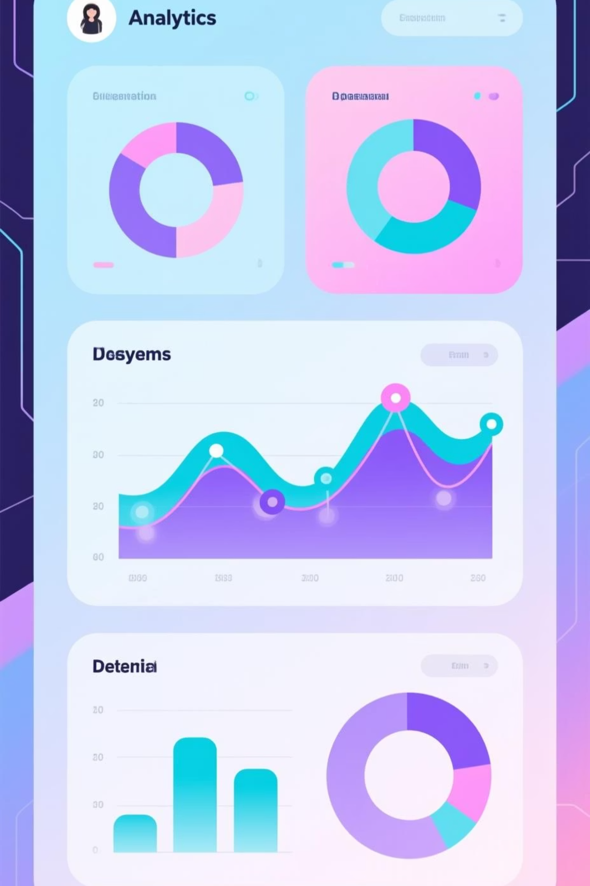
Customer Shopping Behaviour Analysis
Uncovering insights from 3,900 purchases to drive strategic business decisions

Slide 2
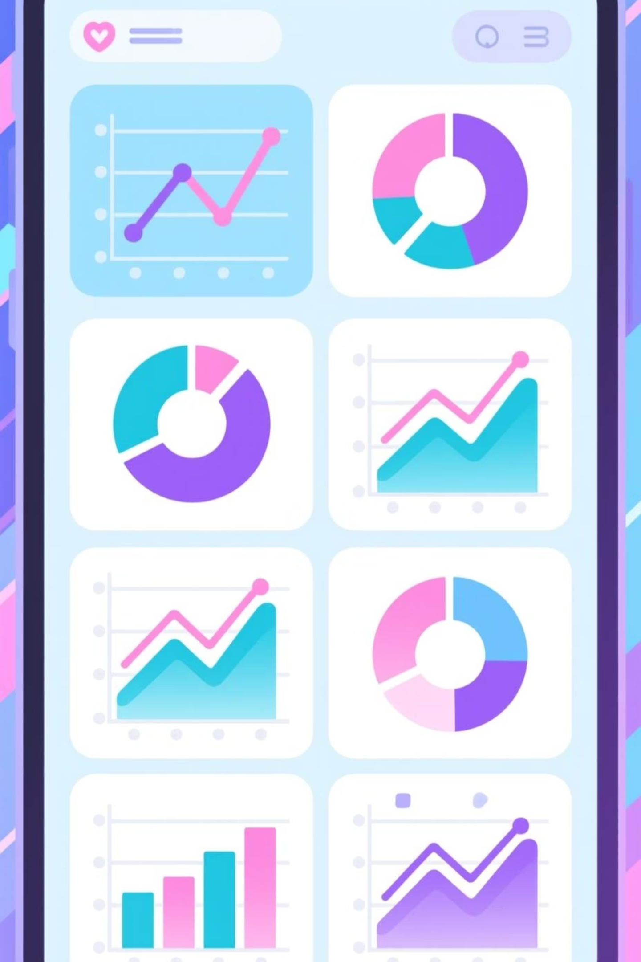
Dataset at a Glance
3.9K
18
25
Total Purchases
Data Points
Product Categories
Transactions analyzed across all categories
Comprehensive customer and purchase attributes
Diverse range of items tracked
50
Locations
Geographic distribution of customers

Slide 3
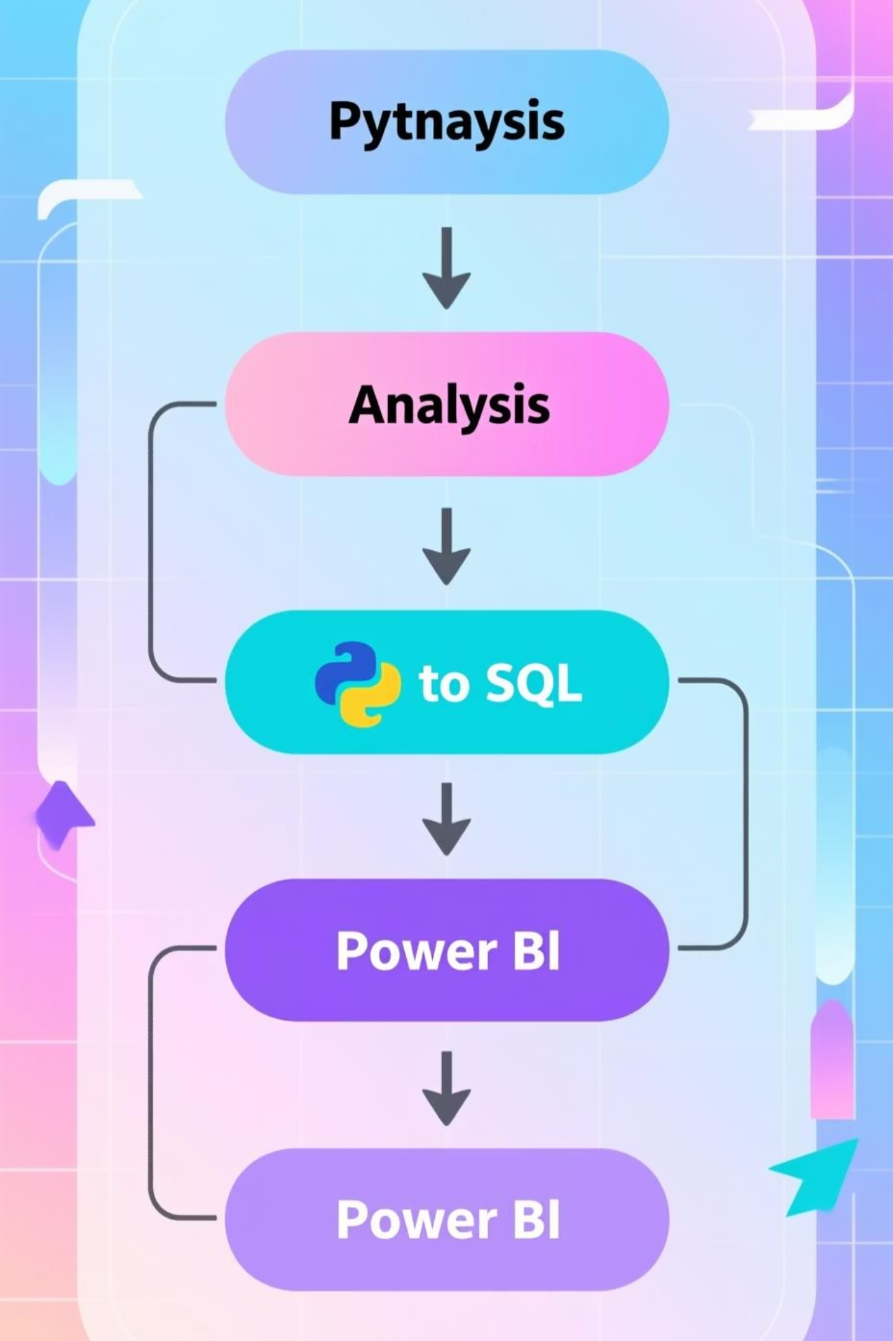
Our Three-Phase Approach
01
02
Python Data Preparation
SQL Business Analysis
Cleaned and engineered features for analysis
Structured queries to answer key questions
03
Power BI Visualization
Interactive dashboard for insights

Slide 4

Data Preparation Highlights
Cleaning & Standardization
Feature Engineering
Database Integration
Created age group segments
Connected to PostgreSQL
Imputed 37 missing review ratings
Loaded cleaned data
Calculated purchase frequency
Standardized column naming
Ready for SQL analysis
Verified data consistency
Removed redundant columns

Slide 5
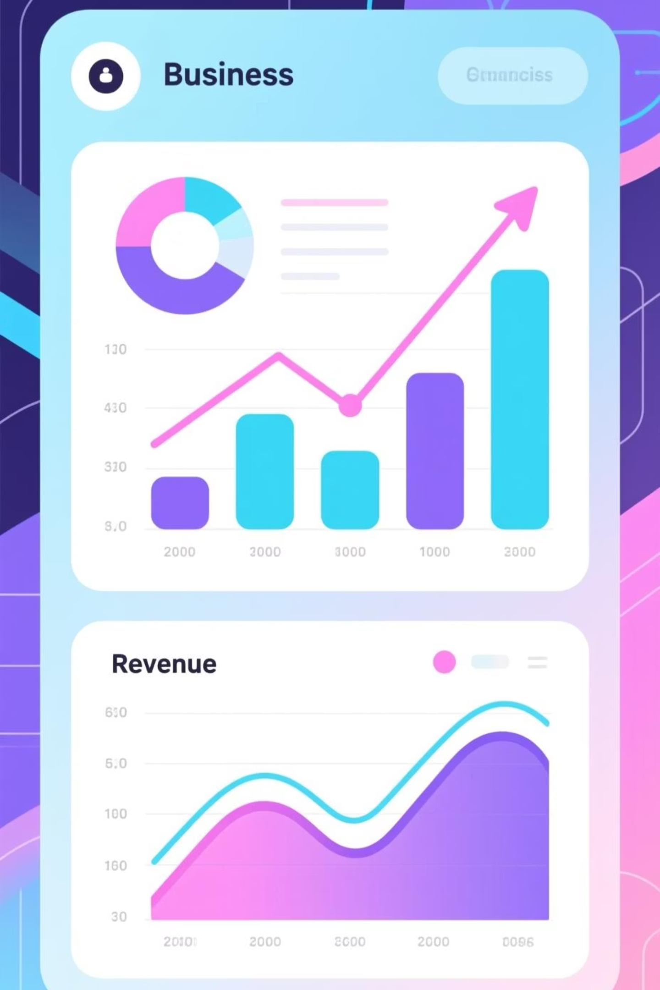
Revenue Insights
Gender Revenue Gap
Shipping Impact
Male customers: $157,890
Express: $60.48 avg
Female customers: $75,191
Standard: $58.46 avg
Males generate 2x more revenue
Premium shipping = higher spend
Category Leader
Clothing dominates with $100K+ revenue
2K sales in clothing alone

Slide 6
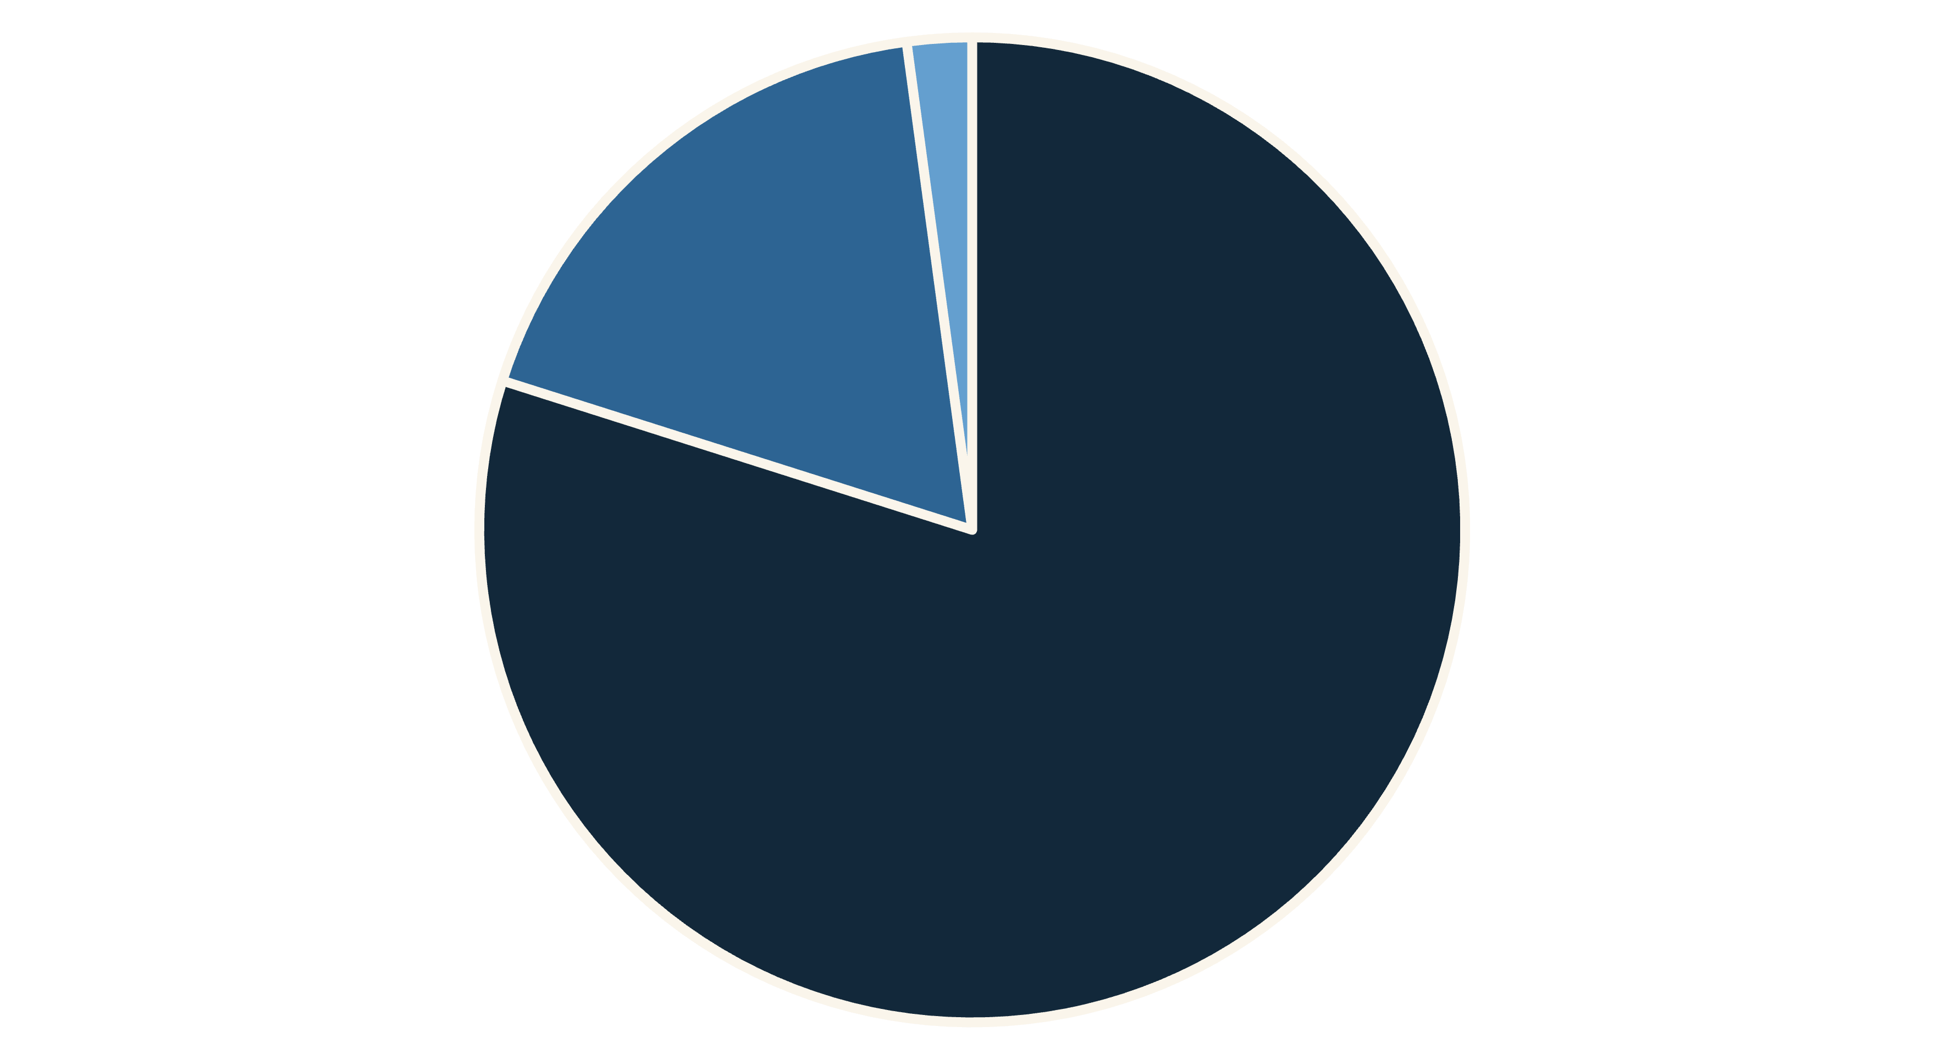
Customer Segmentation
Loyal
Returning
New
80% of customers are loyal buyers with multiple purchases. Focus retention efforts on converting returning customers to loyal status.

Slide 7
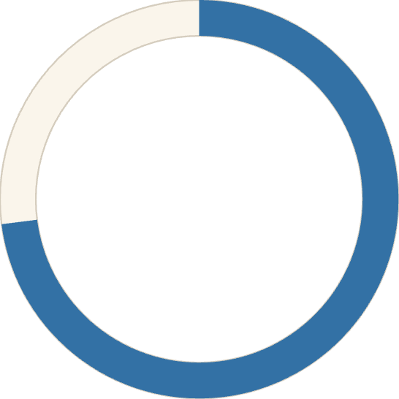

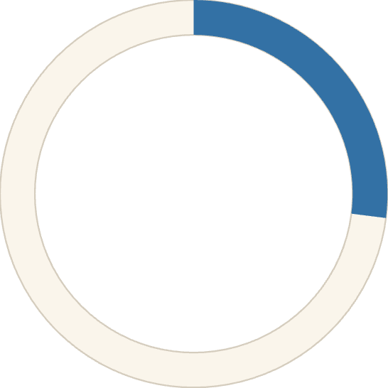
Subscription Analysis
73%
Subscribers
2,847 customers opted in
27%
Non-Subscribers
1,053 customers
Key Finding: Repeat buyers (5+ purchases) show strong subscription correlation with 958 subscribed vs 2,518 non-subscribed

Slide 8
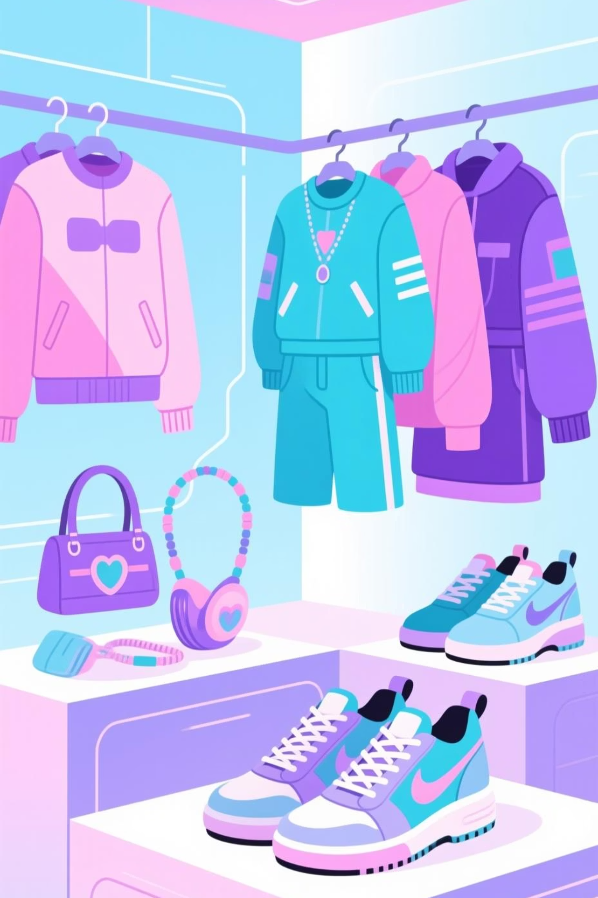
Top Performing Products
Highest Rated
Gloves: 3.86 rating
1
Sandals: 3.84 rating
Boots: 3.82 rating
Most Purchased
Blouse: 171 orders
2
Jewelry: 171 orders
Pants: 171 orders
Discount Dependent
Hat: 50% discounted
3
Sneakers: 49% discounted
Coat: 49% discounted

Slide 9
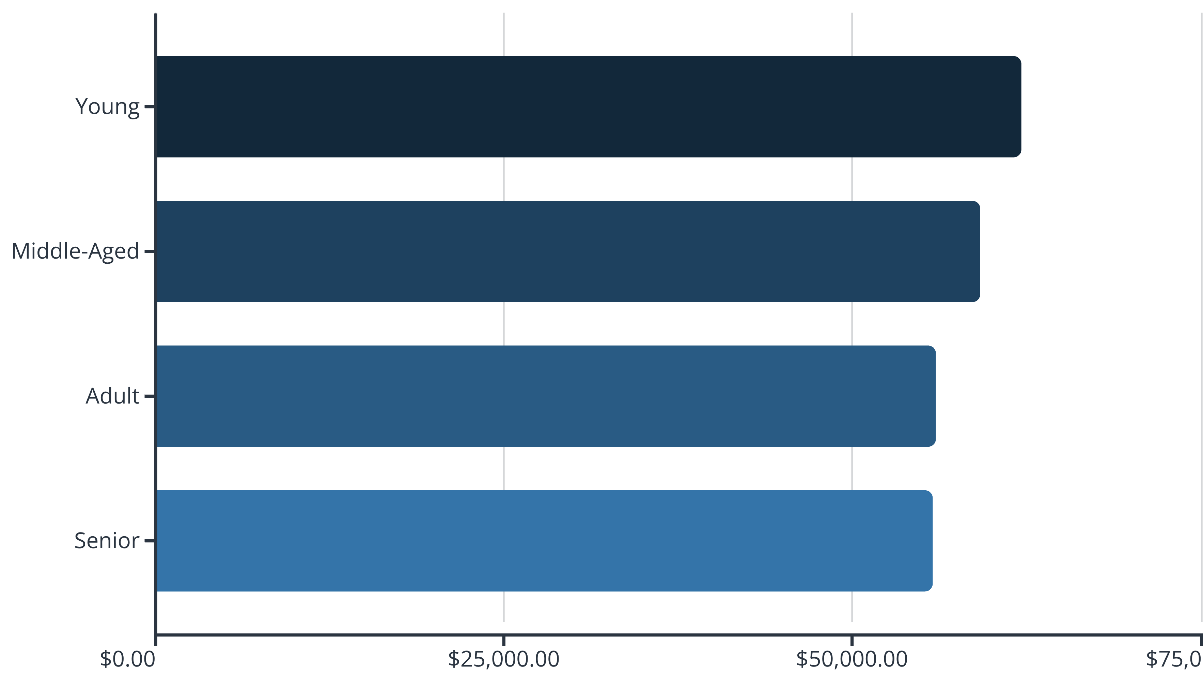
Age Group Revenue Distribution
Young customers lead revenue generation. Target marketing campaigns toward this demographic for maximum ROI.

Slide 10

Strategic Recommendations
Boost Subscriptions
Loyalty Programs
Review Discounts
Promote exclusive benefits to convert the 27% non-subscribers
Reward repeat buyers to accelerate movement into loyal segment
Balance promotional sales with margin control for profitability
Product Positioning
Targeted Marketing
Highlight top-rated items in marketing campaigns
Focus on high-revenue age groups and express shipping users

